Slide 1
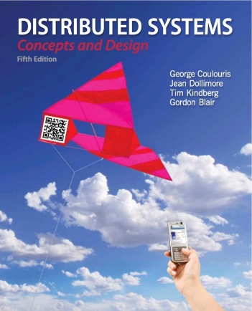
Introduction to Distributed Systems and Characterisation
Dr. Rajkumar Buyya
Cloud Computing and Distributed Systems (CLOUDS) Laboratory
School of Computing and Information Systems
The University of Melbourne, Australia
http://www.buyya.com
http://clouds.cis.unimelb.edu.au/~rbuyya/
Most concepts are
drawn from Chapter 1

Slide 2
Presentation Outline
Introduction
Defining Distributed Systems
Characteristics of Distributed Systems
Example Distributed Systems
Challenges of Distributed Systems
Summary

Slide 3
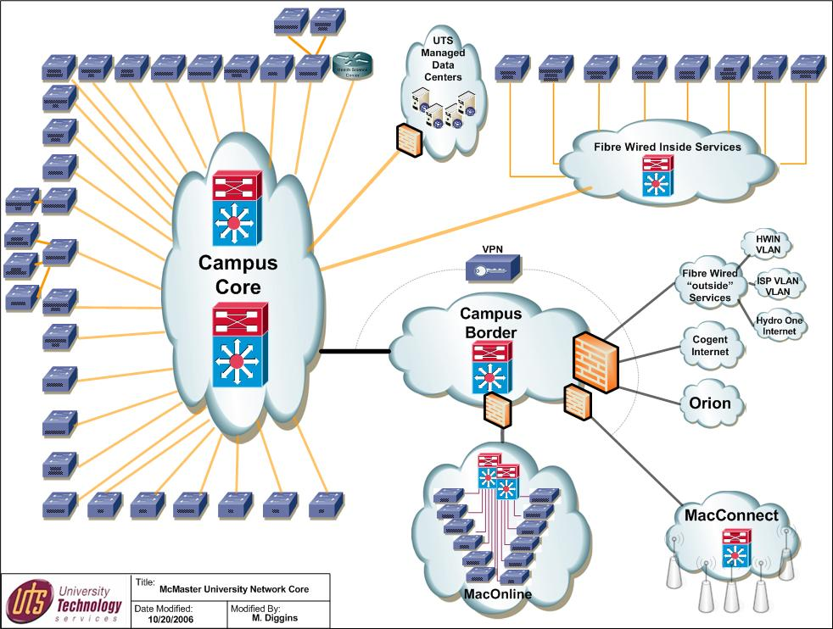
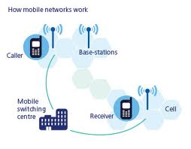
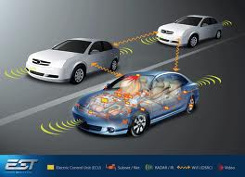
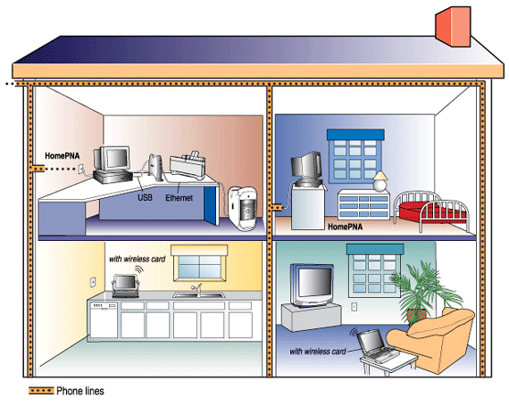

Introduction
Networks of computers are everywhere!
  Mobile phone networks
  Corporate networks
  Factory networks
  Campus networks
  In-car networks
  Internet of Things (IoT)
  On board networks in planes and trains
This subject aims:
  to cover characteristics of networked/distributed computing systems and applications
  to present the main concepts and techniques that have been developed to help in the tasks of designing and implementing systems and applications that are based on networks.
Notes:
Mobile - GSM/3G networks, cell towers connect to backbones
Corporate - LAN, consisting of PC’s, laptops, servers, storage, printing
Factory - Machines (drills, stamps, robots) communicate over network
Campus - Like CSSE Dept / Unimelb. Wired/wireless, clients, servers
Home - Laptops, PC’s, Xbox/Playstation, Set top boxes
In-car - Network of sensors (monitoring engine, breaks, tires etc)

Slide 4
Defining Distributed Systems
“A system in which hardware or software components located at networked computers communicate and coordinate their actions only by message passing.” [Coulouris]
“A distributed system is a collection of independent computers that appear to the users of the system as a single computer.” [Tanenbaum]
Example Distributed Systems:
  Cluster:
    “A type of parallel or distributed processing system, which consists of a collection of interconnected stand-alone computers cooperatively working together as a single, integrated computing resource” [Buyya].
  Cloud:
    “a type of parallel and distributed system consisting of a collection of interconnected and virtualised computers that are dynamically provisioned and presented as one or more unified computing resources based on service-level agreements established through negotiation between the service provider and consumers” [Buyya].
Notes:
Top definition is from CDK book - I would expand the definition to include sensors as well, although sensors could be considered computers.
Second definition encapsulates a key aspect of DS, transparency!
Cluster is typically many machines located in the one place
Grid can consist of many clusters interconnected and shared.

Slide 5

Leslie Lamport’s Definition
"A distributed system is one on which I cannot get any work done because some machine I have never heard of has crashed.“
  Leslie Lamport – a famous researcher on timing, message ordering, and clock synchronization in distributed systems.
Notes:
This is very true….. We depend on networked computers every day, for email, messaging, file storage, websites, etc etc.
E.g. Example of DHCP failure.
Come into the office and the DHCP server is down. As a result, I do not have a correct IP address, I don’t know DNS servers, can’t do any work! Thankfully this doesn’t happen to often.

Slide 6
Networks vs. Distributed Systems
Networks: A media for interconnecting local and wide area computers and exchange messages based on protocols. Network entities are visible and they are explicitly addressed (IP address).
Distributed System: existence of multiple autonomous computers is transparent
However,
  many problems (e.g., openness, reliability) in common, but at different levels.
    Networks focuses on packets, routing, etc., whereas distributed systems focus on applications.
    Every distributed system relies on services provided by a computer network.
Distributed Systems
Computer Networks
Notes:
These protocols are generally ‘well defined’, such as TCP/UDP over IP, IPX, NETBIOS.
In DS, much of the complexity is handled by the network layer, however we cannot assume everything is 100% reliable.
In DS, we operate at a higher level, but we must be mindful of the failures that can and will occur on Computer Networks.

Slide 7
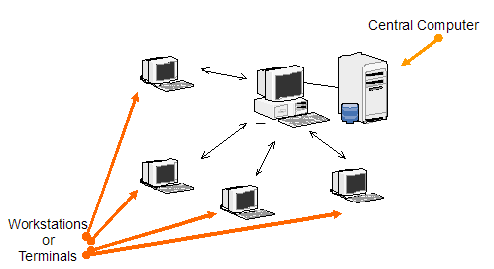
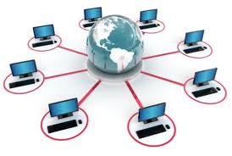
Reasons for Distributed Systems
Functional Separation:
  Existence of computers with different capabilities and purposes:
    Clients and Servers
    Data collection and data processing
Inherent distribution:
  Information:
    Different information is created and maintained by different people (e.g., Web pages)
  People
    Computer supported collaborative work (virtual teams, engineering, virtual surgery)
  Retail store and inventory systems for supermarket chains (e.g., Coles, Woolworths)
Power imbalance and load variation:
  Distribute computational load among different computers.
Reliability:
  Long term preservation and data backup (replication) at different locations.
Economies:
  Sharing a printer by many users and reduce the cost of ownership.
  Building a supercomputer out of a network of computers.
Notes:
There are many practical reasons to utilise DS:
Functional Separation: Beneficial to separate collection from processing
Inherent dist: The process/activity is naturally distributed
Power/ load: We are forced to use DS as one system cannot handle!
Reliability: Government reg. may force us to retain data for 10 years
Economies: Share resources, statistical multiplexing

Slide 8
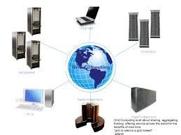
Consequences of Distributed Systems
Computers in distributed systems may be on separate continents, in the same building, or the same room. DSs have the following consequences:
  Concurrency – each system is autonomous.
    Carry out tasks independently
    Tasks coordinate their actions by exchanging messages.
  Heterogeneity
  No global clock
  Independent Failures
Notes:
Consequencies are problems that need solving when we choose DS:
Concurrency: Tasks happen independently, but periodically convenve to exchange status update or other information. We need to deal with it.
Heterogeneity: Different hardware, different software, different protocols
No global clock: We cannot assume correctness of timing given.
Ind. Failures: Many components working together (ie goog), any can fail

Slide 9
Characteristics of Distributed Systems
Parallel activities
  Autonomous components executing concurrent tasks
Communication via message passing
  No shared memory
Resource sharing
  Printer, database, other services
No global state
  No single process can have knowledge of the current global state of the system
No global clock
  Only limited precision for processes to synchronize their clocks
Notes:
Parallel: Participants can execute their own tasks in parallel, with little or no synchronisation
Comms: With wide scale DS, there is no shared memory space to use as a ‘blackboard’. Instead, messages must be passed .
Resource sharing: We need to give ‘fair’ access to many users
No global state: See message passing, can’t know all like on single PC
No global clock: Can assume millesecond accuracy at best

Slide 10
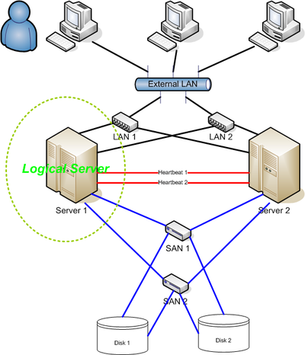
Goals of Distributed Systems
Connecting Users and Resources
Transparency
Openness
Scalability
Enhanced Availability
Notes:
Connecting users: Ultimately we want our system made widely avail.
Transparency: User should be unaware of complexity behind system, access it almost like local system.
Openness: Use standards (like http/ftp, w3 standards) so anyone can interface with, understand and extend your system
Scalability: Having near linear scaling is the ultimate goal, add capacity to deal with growth

Slide 11
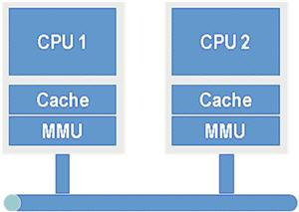
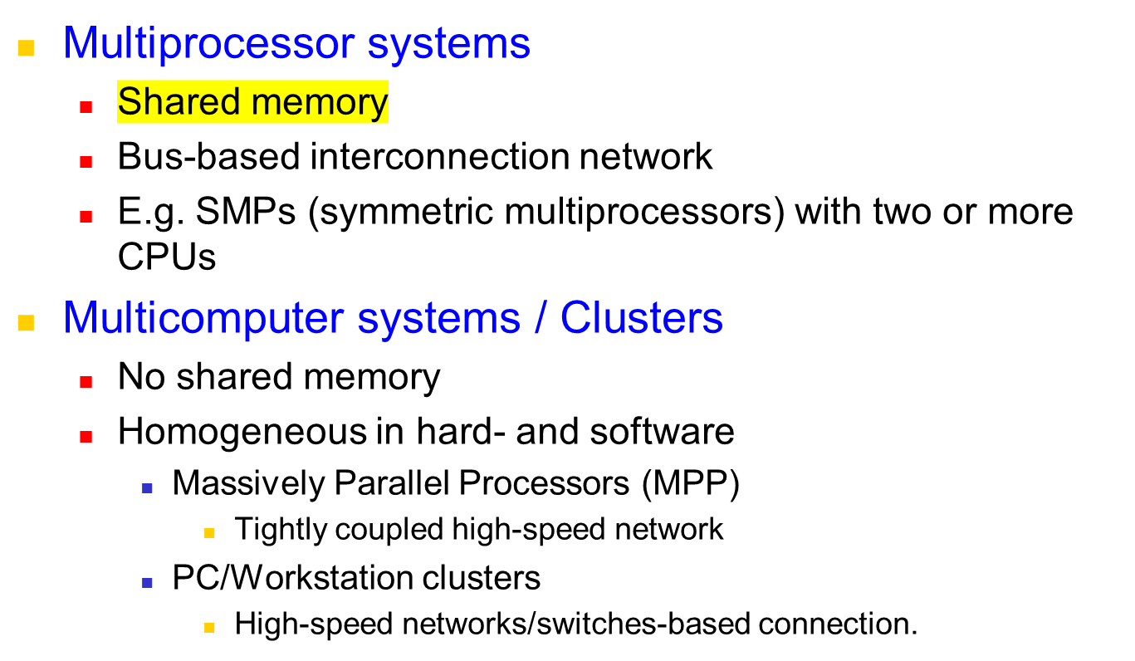
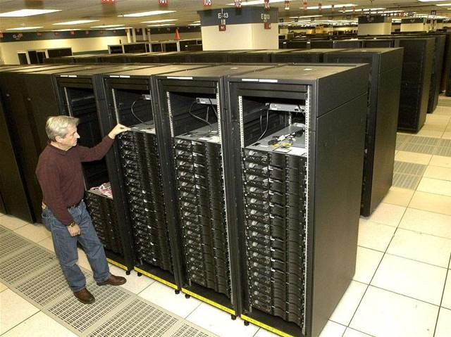
Differentiation with parallel systems
Notes:
Most of today’s supercomputers are MPPs
Densely packed, very expensive systems with thousands of CPUs and high speed interconnects.
What happens when the system runs out of capacity? Buy new, expensive replacement (not cost effective).
Multicomputer: Cluster of identical machines, tightly coupled, typically used for single purpose.

Slide 12
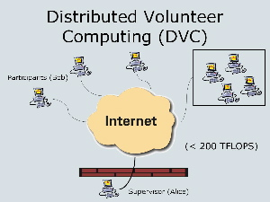
Differentiation with parallel systems is blurring
Extensibility of clusters leads to heterogeneity
  Adding additional nodes as requirements grow
Extending clusters to include user desktops by harnessing their idle resources
  E.g., SETI@Home, Folding@Home
Leading to the rapid convergence of various concepts of parallel and distributed systems
Notes:
Extending existing clusters mighy force heterogeneity. If you buy more resources 2 years later, unlikely to be able to maintain homogeneity.
“Desktop grids” - explain SETI and Folding.
DS can now include existing parallel systems, desktop grid, etc and make them available over a single interface/framework.

Slide 13
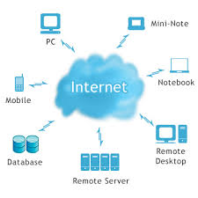



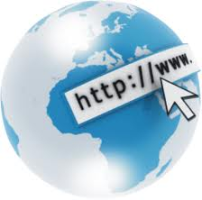

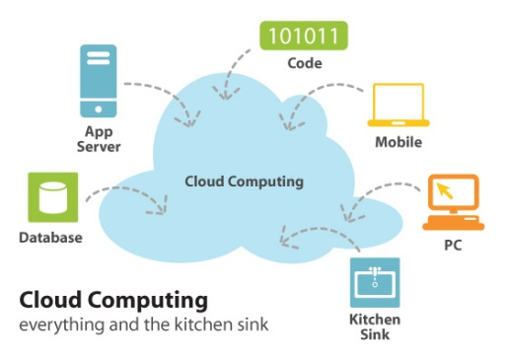
Examples of Distributed Systems
They (DS) are based on familiar and widely used computer networks:
  Internet
  Intranets, and
  Wireless networks
Example DS and its Applications:
  Web (and many of its applications like Online bookshop)
  Data Centers and Clouds
  Wide area storage systems
  Banking Systems
  User-level communication (Facebook, Zoom)
Notes:
Most of you should have used all of these DS.

Slide 14
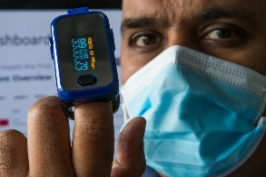
Selected application domains and associated networked applications
Finance and Commerce | eCommerce e.g. Amazon and eBay, PayPal, online banking and trading
The Information Society | Web information and search engines, ebooks, Wikipedia; social networking: Facebook, Twitter, and WeChat.
Creative Industries and Entertainment | Online gaming, music and film in the home, user-generated content, e.g. YouTube, Flickr, Netflix
Healthcare | Health informatics, on online patient records, monitoring patients (CovidCare, developed by Alfred Health)
Education | e-learning, virtual learning environments; distance learning. e.g., Coursera
Transport and Logistics | GPS in route finding systems, map services: Google Maps, Google Earth
Science and Engineering | Cloud computing as an enabling technology for collaboration between scientists (LHC, LIGO)
Environmental Management | Sensor networks to monitor earthquakes, floods or tsunamis (Bureau of Meteorology flood warning system)

Slide 15






A typical portion of the Internet and its services:
Multimedia services providing access to music, radio, TV channels, and video conferencing supporting several users.
Intranet

ISP



backbone
satellite link
desktop computer:
server:
network link:
The Internet is a vast collection of computer networks of many different types and hosts various types of services.
Notes:
Programs run on computers, and they interact via message passing
The internet is a very large DS, consisting of many participants.
Governments, and large telcos operate the backbones that carry the bulk of the traffic
ISP’s provide connectivity between the backbones and smaller networks
Many services run, email, www, ftp, video/audio streaming etc.

Slide 16










A typical Intranet:
A portion of Internet that is separately administered & supports internal sharing of resources (file/storage systems and printers)
Desktop
computers
Print and other servers
email server
Local area
Web server
network
email server
print
File server
other servers
the rest of
the Internet
router/firewall
Notes:
Intranet is a seperately administered DS, that has a boundary between intra and internet.
Intranet can be one small LAN or many interconnected private sites.
Firewall can be used to allow authorised users in & out but keep unwanted / malicious users from causing harm.
Some intranets (e.g. Defence, Hospitals) may choose to keep them entirely separate from the internet to ensure security.

Slide 17



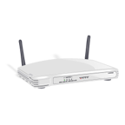





Mobile and ubiquitous computing: portable and handheld devices in a distributed system
Internet
WAP (Wireless
App Protocol)
Home Intranet
Host Intranet
Wireless LAN
gateway
Printer
Mobile
phone
Camera
Laptop
Host site
Supports continued access to Home intranet resources via wireless and provision to utilise resources (e.g., printers) that are conveniently located (location-aware computing).
Notes:
We are at a point where many of our devices have short (BT) and medium range (WiFi) wireless - camera, PDA, mobile, laptop, etc
They are creating ad-hoc DS in our homes!
Bonjour / Zeroconf enable location aware, ad-hoc distributed computing - find local file servers, printers, other users via advertising messages

Slide 18

Resource sharing and the Web: open protocols, scalable servers, and pluggable browsers
http://www.google.com/search?q=Buyya
www.google.com
Web servers
Browsers
www.cdk5.net
Internet
Internet
http://www.cdk5.net/
www.w3c.org
File system of
http://www.w3c.org/Protocols/Activity.html
www.w3c.org
Protocols
Activity.html
Notes:
User types in a URL into a web browser, and many things happen:
The server that hosts the page is located
The protocol is identified (in this case, HTTP)
The relevant service is called upon (e.g. the webserver) to satsify request
The particular page that is requested is located and returned to user

Slide 19
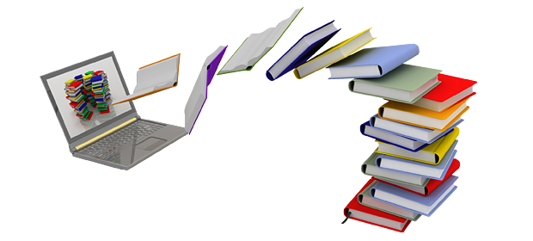

Business Example and Challenges
Online bookstore (e.g., in World Wide Web)
  Customers can connect their computer to your computer (web server):
    Browse your inventory
    Place orders
    …
This example has been adapted from Torbin Weis, Berlin University of Technology
Notes:
Amazon.com is the biggest example of this
They would typically service tens of thousands of customers at a time.
Would one server be enough to handle this example? No!
Amazon.com is inherently distributed - Warehouses locateed across the country and globe, many international stores (US, UK, Germany, Japan). Well suited to a distributed approach, both physically and logically.

Slide 20
Business Example – Challenges I
What if
  Your customer uses a completely different hardware? (PC, MAC, iPad, Mobile…)
  … a different operating system? (Windows, Unix,…)
  … a different way of representing data? (ASCII, EBCDIC,…)
  Heterogeneity
Or
  You want to move your business and computers to the Caribbean (because of the weather or low tax)?
  Your client moves to the Caribbean (more likely)?
  Distribution transparency
Notes:
As a business that uses a DS approach, they face many challenges:
Hardware: PC, Mac, Sun,
OS: Windows, Linux, MacOS, FreeBSD
Data: Different formats and ways of representing the same info
Move the business: Complex when infrastructure is distributed
Clients move: You need to make sure they are still well services, have the same experience no matter where they are (ie. Caching, Load Bal.)

Slide 21
Business Example – Challenges II
What if
  Two customers want to order the same item at the same time?
  Concurrency
Or
  The database with your inventory information crashes?
  Your customer’s computer crashes in the middle of an order?
  Fault tolerance
Notes:
As DS designers you need to handle these common events - you cannot assume that they won’t happen!
Concurrency: Access to a shared resource must be synchronised so that data remains consistent (I.e. via semaphores/locks)
Faults/Failures: Independent failures shouldn’t cripple the whole system. Design to deal with failures as gracefully as you can.

Slide 22
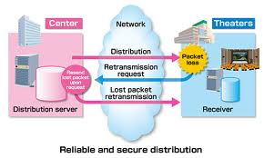
Business Example – Challenges III
What if
  Someone tries to break into your
  system to steal data?
  … sniffs for information?
  … your customer orders something and doesn’t accept the delivery saying he didn’t?
  Security
Or
  You are so successful that millions of people are visiting your online store at the same time?
  Scalability
Notes:
Security: Firewalls and other filtering methods can limit attackers ability to braek in.
Encryption can protect the integrity of data sent between clients and servers.
Non-repudiation techniques such as digital signitures can ensure customer cannot lie about their activities.
Scalability: How can we scale out. Does our DS design allow this?

Slide 23

Business Example – Challenges IV
When building the system…
  Do you want to write the whole software on your own (network, database,…)?
  What about updates, new technologies?
  Reuse and Openness (Standards)
Notes:
We don’t have to reinvent the wheel, there are many tools that can help:
E.g. Can implement online book store via LAMP stack or off the shelf system.
Can use J2EE to handle many key aspects of DS design (encryption, scalability, message passing, etc).
Reuse and open standards help us out a lot. E.g. Corba via C or Java.

Slide 24
Overview Challenges I
Heterogeneity
  Heterogeneous components must be able to interoperate
Distribution transparency
  Distribution should be hidden from the user as much as possible
Fault tolerance
  Failure of a component (partial failure) should not result in failure of the whole system
Scalability
  System should work efficiently with an increasing number of users
  System performance should increase with inclusion of additional resources
Notes:
Heterogeneity: Big/Little Endian, other platform differences have mostly been solved thanks to new DS protocols, TCP/IP, WS, Corba etc
Dist. Transparency: We can utilise services like DNS and Hyperlinks to mask the fact that many machines are involved in DS.
Fault tolerance: Can be achieved via careful programming and assumptions, replicated (eg fall-over) servers for backup.
Scalability: Smart load distribution / balancing, good scalable design.

Slide 25
Overview Challenges II
Concurrency
  Shared access to resources must be possible
Openness
  Interfaces should be publicly available to ease inclusion of new components
Security
  The system should only be used in the way intended
Notes:
Concurrency: Access to a shared resource must be synchronised so that data remains consistent (I.e. via semaphores/locks). Most modern programming languages (like Java) do the hard work for us, so no excuses!!
Openness: Open standards, open API’s, open message protocols
Security: Good secure design, combining encryption, authentication and access control.

Slide 26
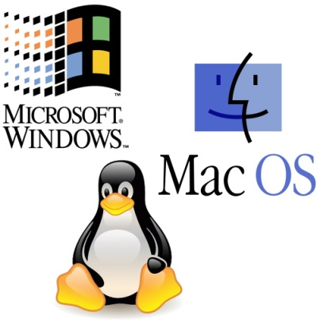
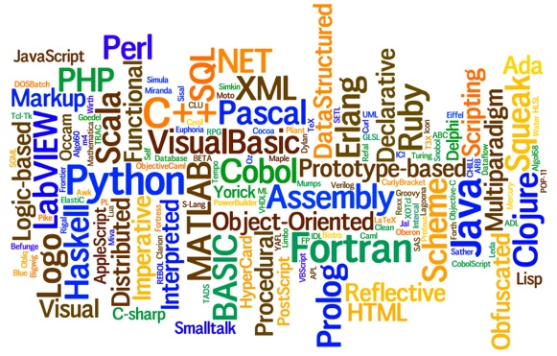
Heterogeneity
Heterogeneous components must be able to interoperate across different:
  Operating systems
  Hardware architectures
  Communication architectures
  Programming languages
  Software interfaces
  Security measures
  Information representation
Notes:
Different OS: Windows, MacOS, Linux, BSD
Hardware: Intel, PowerPC, Sparc, ARM
Comm. Arch’s:
Programming Languages: C/C++, Java, Perl, Python, Ruby, etc
Software interfaces: Common interfaces are needed (RPC, WS)
Security measures: Need to talk same language (3DES, Blowfish, etc)

Slide 27
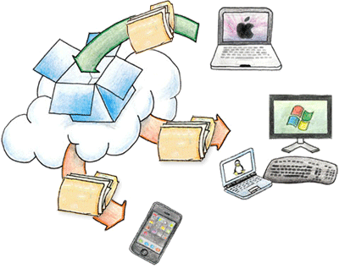
Distribution Transparency I
To hide from the user and the application programmer the separation/distribution of components, so that the system is perceived as a whole rather than a collection of independent components.
ISO Reference Model for Open Distributed Processing (ODP) identifies the following forms of transparencies:
Access transparency
  Access to local or remote resources is identical
  E.g. Network File System / Dropbox
Location transparency
  Access without knowledge of location
  E.g. separation of domain name from
  machine address.
Failure transparency
  Tasks can be completed despite failures
  E.g. message retransmission, failure of a
  Web server node should not bring down the website.
Notes:
Access transparency: Most modern OS provide this for us. Once remote FS is mounted, we work with it like a local drive
Location transparency: DNS gives us this. If server moves and changes IP, DNS will always point to current location (with some limits)
Failure transparency: Can be solved by good design - message retransmission, hot spares, self healing architectures.

Slide 28
Distribution Transparency II
Replication transparency
  Access to replicated resources as if there was just one. And provide enhanced reliability and performance without knowledge of the replicas by users or application programmers.
Migration (mobility/relocation) transparency
  Allow the movement of resources and clients within a system without affecting the operation of users or applications.
  E.g. switching from one name server to another at runtime; migration of an agent/process from one node to another.
Notes:
Replication transparency: DNS can achieve this. Eg: google.com goes
To {host1.google.com, host2.google.com, …hostn.google.com, etc}
User is unaware they have been redirected.
Migration: Server migration is well covered by DNS. DS Services should be created to not be confused when client rapidly changes location (e.g. 3g user, or wifi changing hotspots).

Slide 29
Distribution Transparency III
Concurrency transparency
  A process should not notice that there are other sharing the same resources
Performance transparency:
  Allows the system to be reconfigured to improve performance as loads vary
  E.g., dynamic addition/deletion of components, switching from linear structures to hierarchical structures when the number of users increase
Scaling transparency:
  Allows the system and applications to expand in scale without changes in the system structure or the application algorithms.
Application level transparencies:
  Persistence transparency
    Masks the deactivation and reactivation of an object
  Transaction transparency
    Hides the coordination required to satisfy the transactional properties of operations
Notes:
Concurrency transparency: The fact that many users are competing for one resource can be hidden by good scheduling
Performance / Scaling transperency: Inter-related, DS should be agile enough to expand when load increases and contract during quiet times.
This requires careful initial design.
Application level: Persistance for end users, they should not need to login constantly. Transactions should happen without undue delay

Slide 30
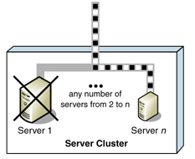
Fault Tolerance
Failure: an offered service no longer complies with its specification (e.g., no longer available or very slow to be usable)
Fault: cause of a failure (e.g. crash of a component)
Fault tolerance: no failure despite faults
i.e., programmed to handle failures
and hides them from users.
Notes:
Failure: service can be no longer available, or be so slow as to be unusable.
Fault: the component that is not functioning correctly.
Fault tolerence: programmed to handle failures if and when they happen, in a graceful way that hides them from users.

Slide 31
Fault Tolerance Mechanisms
Fault detection
  Checksums, heartbeat, …
Fault masking
  Retransmission of corrupted messages, redundancy, …
Fault toleration
  Exception handling, timeouts,…
Fault recovery
  Rollback mechanisms,…
Notes:
Detection: Checksum, check integrity of messages (Hash, md5).
Masking: TCP handles retransmission, we can add our own application level fault masking for better reliability.
Toleration: Handle faults, delays gracefully.
Recovery: If something bad DOES happen, hopefully we know about it (!!) and we can roll back to a known good state.

Slide 32
Scalability
System should work efficiently at many different scales, ranging from a small Intranet to the Internet
Remains effective when there is a significant increase in the number of resources and the number of users
Challenges of designing scalable distributed systems:
  Cost of physical resources
    Cost should linearly increase with system size
  Performance Loss
    For example, in hierarchically structure data, search performance loss due to data growth should not be beyond O(log n), where n is the size of data
  Preventing software resources running out:
    Numbers used to represent Internet addresses (32 bit->64bit)
    Y2K-like problems
  Avoiding performance bottlenecks:
    Use of decentralized algorithms (centralized DNS to decentralized)
Notes:
Scalability can be difficult to achieve depending on application domain.
Services can receive huge increases in traffic (e.g. when featured on slashdot/digg, etc).
We want to be able to add commodity (cheap) servers to increase cap.
Static file serving: Add more servers, adjust DNS
Dynamic web page serving: Add more servers, replicate and synchronise (cluster) back-end DB, adjust DNS

Slide 33
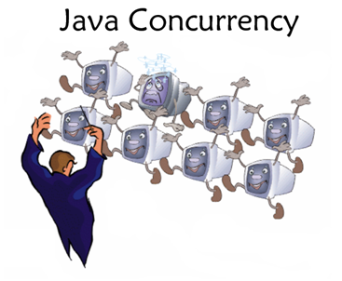
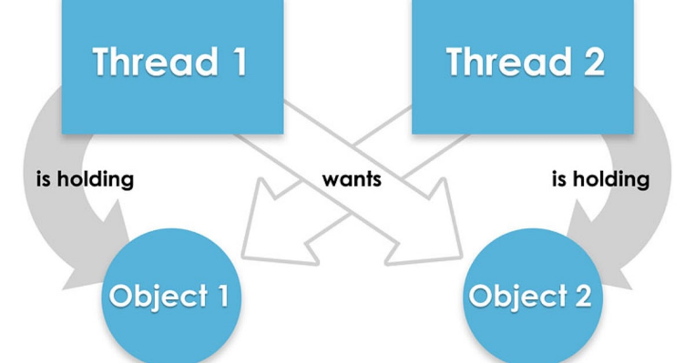
Concurrency
Provide and manage concurrent access to shared resources:
  Fair scheduling
  Preserve dependencies (e.g. distributed transactions -- buy a book using Credit card, make sure user has sufficient funds prior to finalizing order )
  Avoid deadlocks
Notes:
Fair scheduling ensures everyone gets a turn on a popular resource
Dependencies occur for transactions. Eg. Buy a book with Credit Card, check that user has sufficient funds before finalising the transaction
Deadlocks can occur when two users hold a resource, and they are waiting for each other to release their respective resource.

Slide 34
Openness and Interoperability
IE
(Microsoft)
Client in
Python
Firefox
C/C++
Chrome
(Google)
Server in
Java
Open system:
"... a system that implements sufficient open specifications for interfaces, services, and supporting formats to enable properly engineered applications software to be ported across a wide range of systems with minimal changes, to interoperate with other applications on local and remote systems, and to interact with users in a style which facilitates user portability" (POSIX Open Systems Environment, IEEE POSIX 1003.0)
Open spec/standard developers - communities:
  ANSI, IETF, W3C, ISO, IEEE, OMG, Trade associations,...
Notes:
ANSI C - standard, portable way of programming C
W3C - defines key protocols like HTML, Web Services, SOAP, CSS
IEEE - defines standards like 802.1a/b/g/n
Standards are important or we’d never get anything done.

Slide 35
Security I
Resources are accessible to authorized users and used in the way they are intended
Confidentiality
  Protection against disclosure to unauthorized individual information
  E.g., ACLs (access control lists) to provide authorized access to information
Integrity
  Protection against alteration or corruption
  E.g., changing the account number or amount value in a money order
Notes:
Confidentiality: Ensure that user’s information is not comprised or exposed
ACL ensures that only certain people can access service, and can be restricted to certain locations (e.g. IP’s, subnets)
Integrity: We can encrypt data transferred, and/or perform checksums/hash to verify integrity of message.

Slide 36
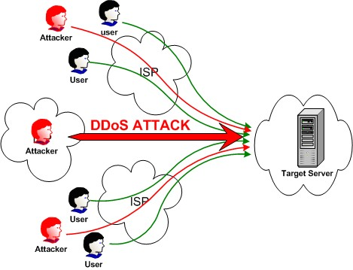
Security II
Availability
  Protection against interference targeting access to the resources.
  E.g., denial of service (DoS, DDoS) attacks
Non-repudiation
  Proof of sending / receiving
  an information
  E.g., digital signature
Notes:
Availability: Maintaining uptime is crucial to given end-users confidence in your service. Study has shown uses wait only a few seconds before giving up on a loading webpage. That can cost $$$$$$
Need to protect against DoS/DDoS… attack that imitates normal access of the service/.
Non-repudiation: Proof that a user sent a particular message or made transaction - they cannot deny doing so after the fact.

Slide 37
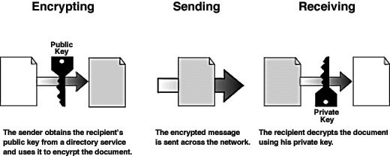
Security Mechanisms
Encryption
  E.g., Blowfish, RSA
Authentication
  E.g., password, public key authentication
Authorization
  E.g., access control lists
Notes:
Blowfish is a general-purpose encryption algorithm, intended as a replacement for the aging DES
RSA is a public key encryption algorithm that is suitable for signing as well as encryption
Authentication can be via standard user/pass or public key auth
Access Control Lists can control who can access a service, which parts of the service they can use and where they access it from.

Slide 38


Summary
Distributed Systems are pervasive/everywhere
Internet enables users throughout the world to access its (application) services from anywhere
Resource sharing is the main motivating factor for constructing distributed systems
Construction of DS faces many challenges/issues:
  Heterogeneity, Openness, Security, Scalability, Failure handling, Concurrency, and Transparency
Distributed systems enable globalization:
  Community (Virtual teams, social networks)
  Science (e-Science, e-Health)
  Business (..e-Banking..)
  Entertainment (YouTube, Meta.com)
  Communication (Zoom,..)

